Slide 1
TRB Planning Applications
Urban Freight Delivery Discussion Panel
Thomas Hill, Florida Department of Transportation
June 2, 2019

Slide 2
What else can we do?
Look internal to other offices and disciplines.
Create data where limited information exists.
Research
Data fusion
Get familiar with the flow of money.
Market your administration.
Get comfortable with fuzzy data.

Slide 3
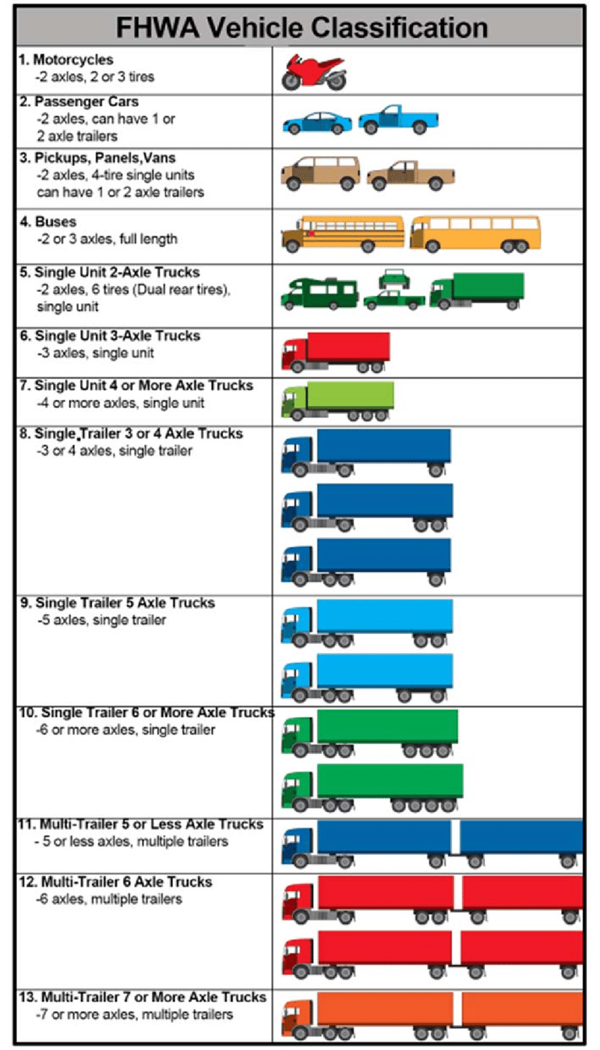
Truck Taxonomy
FDOT Research Projects, Currently Active
Use of Video and Weigh-In-Motion (WIM) Technology.
Goal: Use computer vision and machine learning
automatically classify vehicles and
recognize the vendor and the type of commodity.

Slide 4
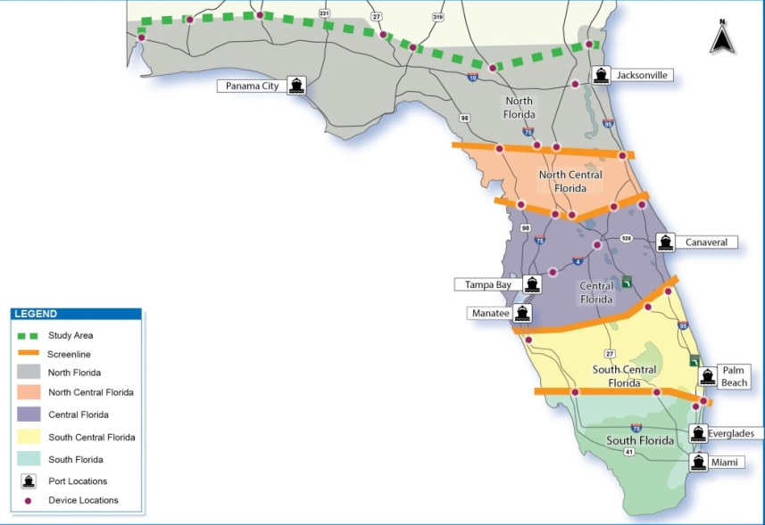
Florida Ports Bluetooth Study

Slide 5
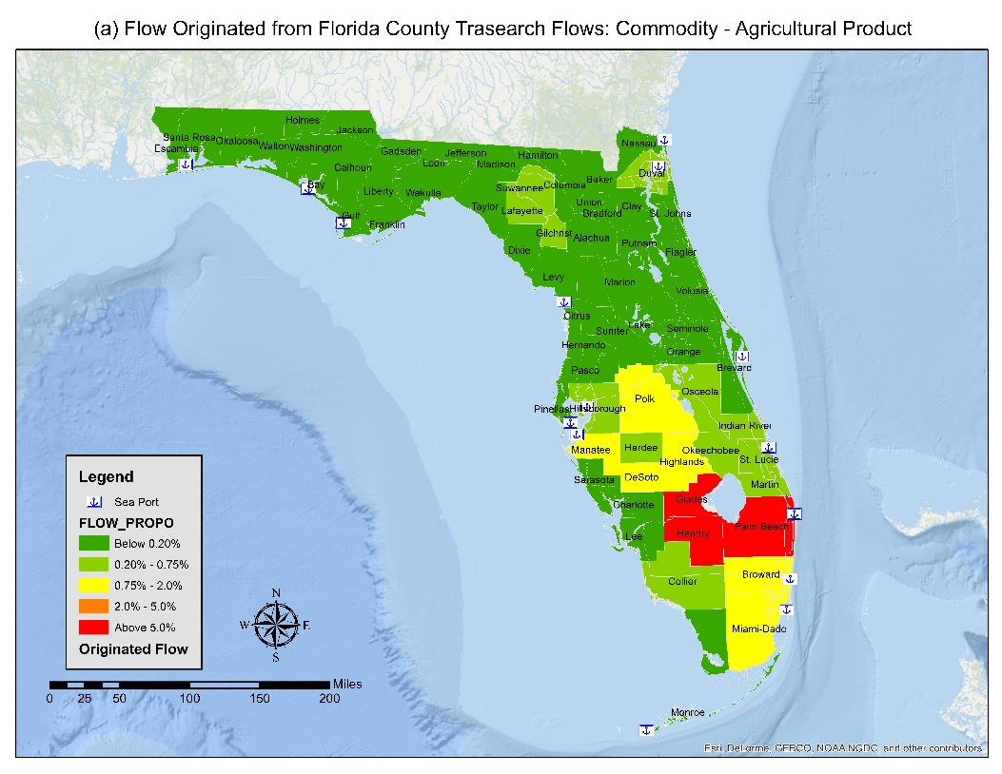
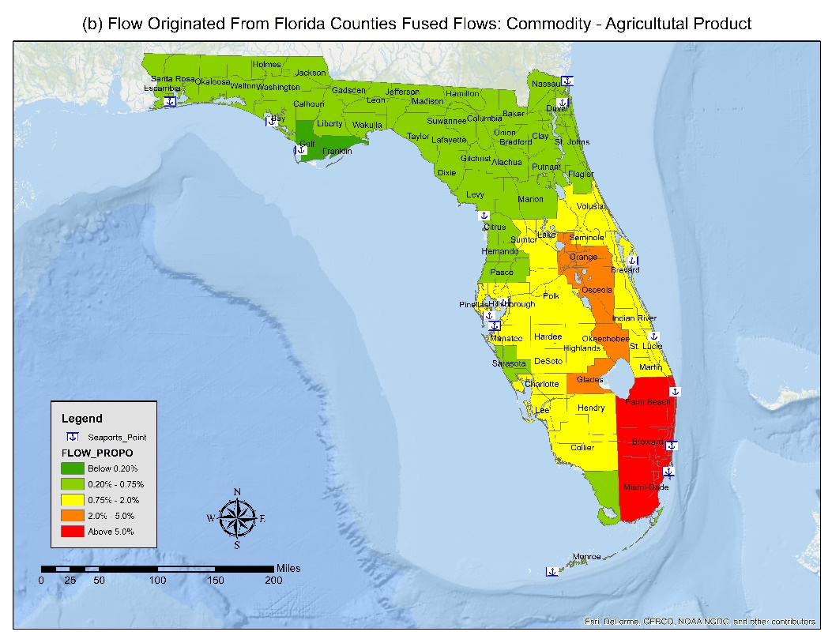
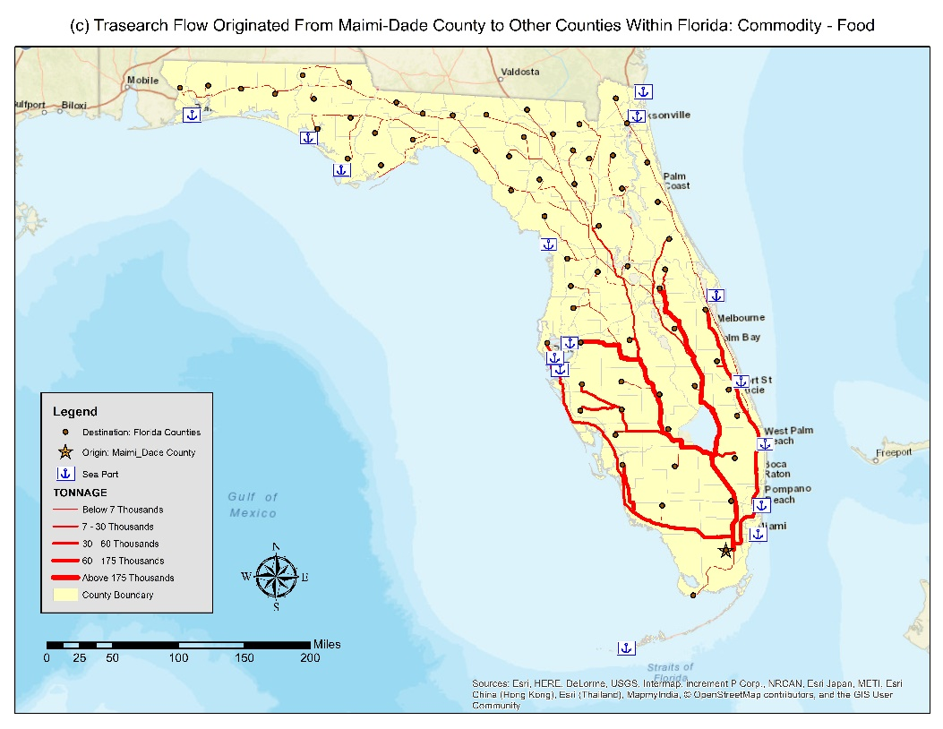
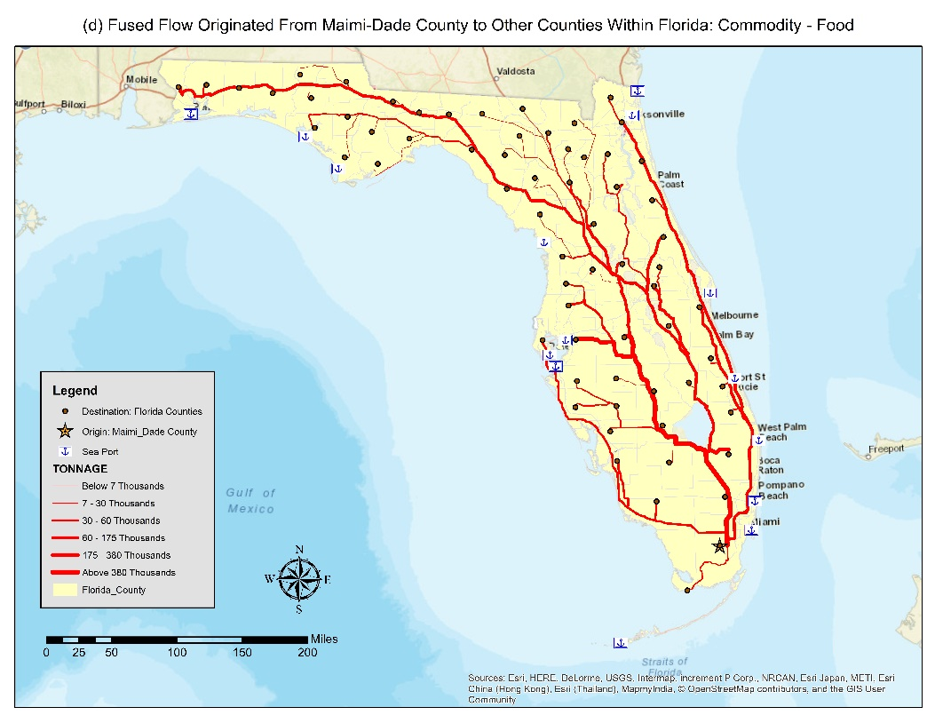
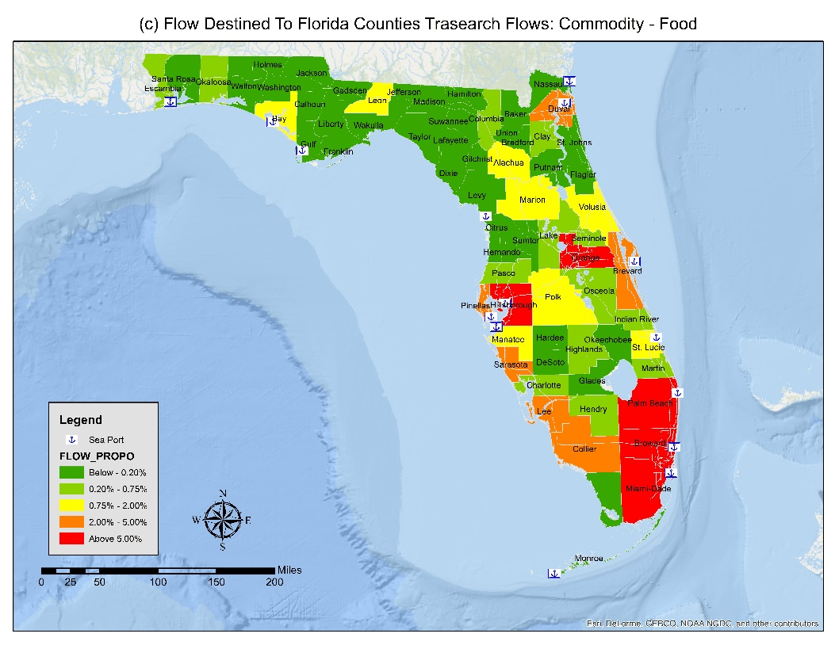
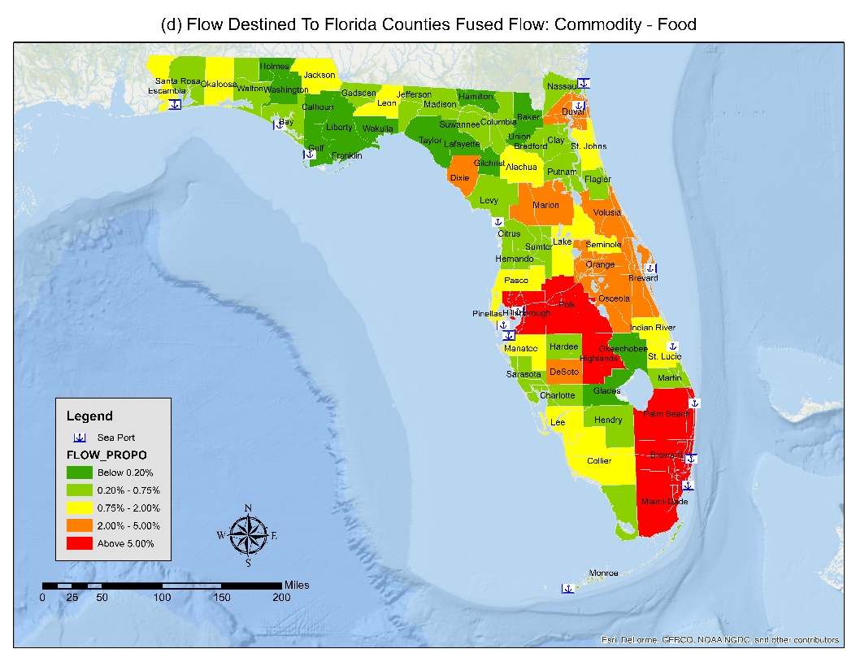
FAF Data fusion
TS flows at origin (Agricultural Product)
Fused flows at origin (Agricultural Product)
TS flows from Miami-Dade County to other counties : Food
Fused flows from Miami-Dade County to other counties : Food
TS flows at destination (Food)
Fused flows at destination (Food)

Slide 6
Firm Evolution
Firm Birth
Attributes of employment size and type are sampled at random from population
Firm Death
Binary choice model – firm is the unit of analysis determining the probability of death.
One model specified by controlling for industry type
Within-migration
Binary choice – firm is the unit that determines probability of relocation.
One model specified by controlling for industry type
In-migrate
Determine a fixed rate of in-migration from data
Poisson distribution is fitted to the data, for sampling new born
Out-migrate
Determine a fixed rate of out-migration from data
Employment Growth/Decline
Log-linear specification of employment size
Control for previous year employment to determine future
Location choice
MNL specification with universal utility function
Control for industry type in model specification
Applied to – birth, within-migration and in-migration firms

Slide 7
Summary
Forecasting the future
Need to be creative presenting future year scenarios
Cannot be constrained by the “lack of data”
We are not wrong – yet.

